Slide 1

CSA 1220 – COMPUTER ARCHITECTURE FOR FUTURE ENGINEERS
SIMULATION OF CACHE AND VIRTUAL PAGING FOR IMPROVED MEMORY PERFORMANCE AND ANALYSIS
GUIDED BY
DR.T. KUMARAGURUBARAN
DR. S. SENTHILVADIVU
PRESENTED BY
MEGALA.P (192573019)
PALLAVI.K (192565055)
POOJITHA.P (192525117)

Slide 2
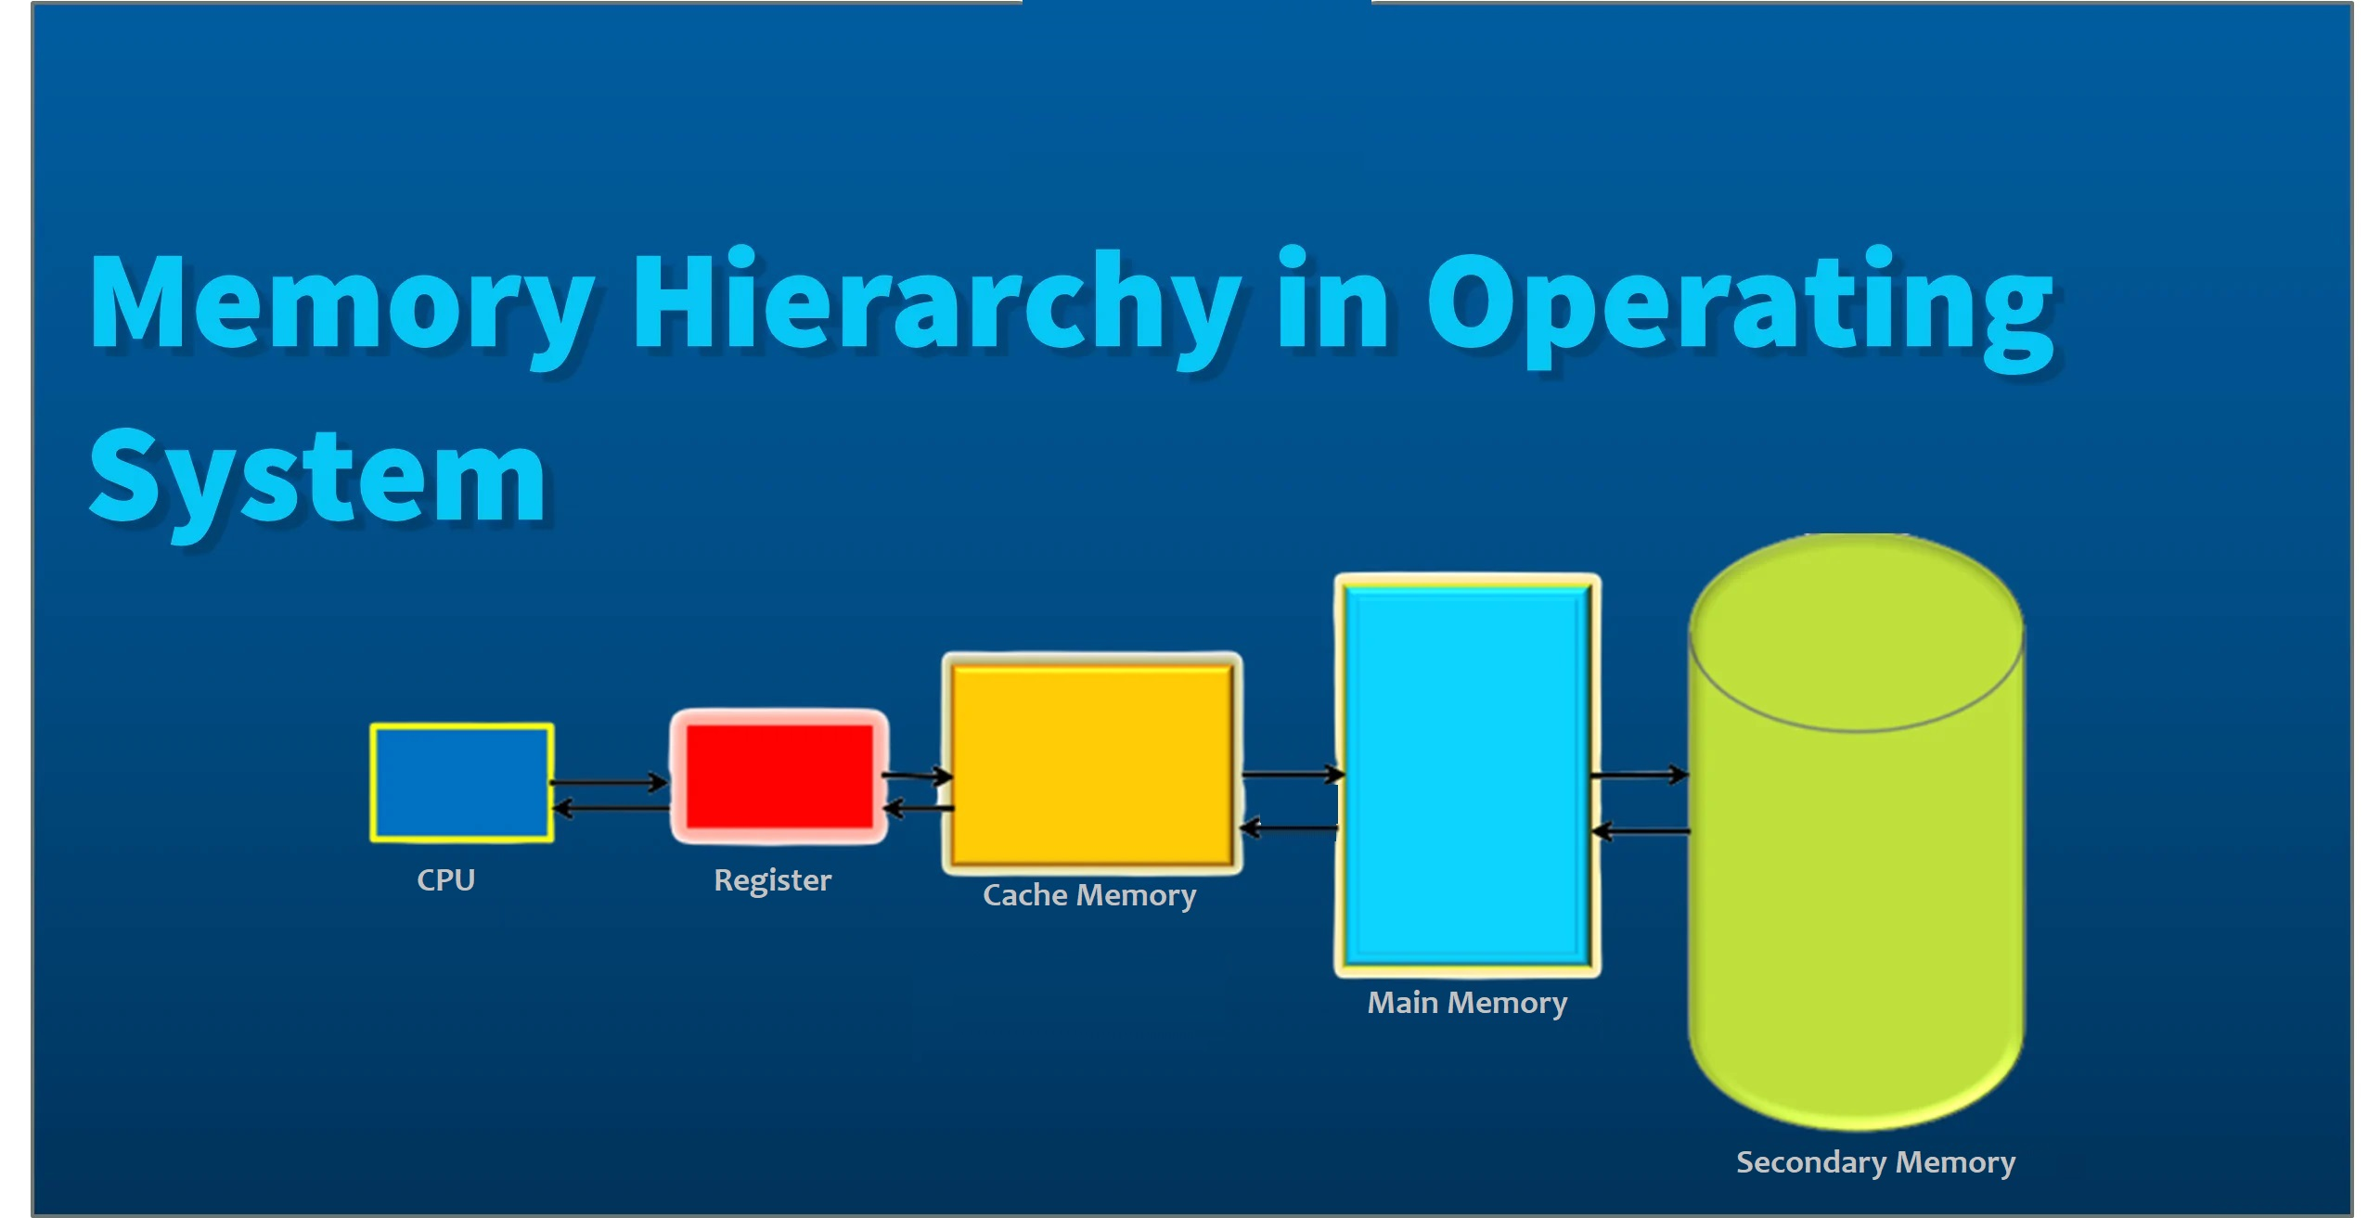
OVERVIEW
Introduction
Objective
Literature Survey
Problem Statement
Methodology
Architecture Diagram
Module-1(Cache memory stimulation)
Module-2(Virtual paging stimulation)
C programming
Conclusion

Slide 3
INTRODUCTION
Modern computer systems rely on a memory hierarchy to balance speed, cost, and capacity.
The hierarchy typically includes cache memory, main memory (RAM), and secondary storage (disk/virtual memory).
Cache memory provides high-speed data access, reducing the average time required to fetch instructions and data.
Virtual paging allows efficient use of physical memory by dividing logical memory into pages and mapping them to frames in physical memory.
Page replacement algorithms (e.g., FIFO, LRU, Optimal) are essential to manage memory when page faults occur.

Slide 4
OBJECTIVE
Provide a clear understanding of how cache memory and virtual paging improve system performance.
Demonstrate the working of different cache mapping techniques such as direct, associative, and set-associative.
Simulate the process of address translation using virtual memory and page tables.
Implement and compare page replacement algorithms like FIFO, LRU, and Optimal.
Analyze the impact of cache hit/miss ratio and page fault rate on system efficiency.

Slide 5
LITERATURE SURVEY
Title | Author | Year | Methodology | Inferences
Cache Performance Analysis in Hierarchical Memory Systems | James Miller, Laura White | 2023 | Analyzes cache hit/miss behavior using simulation tools for varying cache sizes and policies. | Cache configuration directly impacts system performance and access latency.
Simulation of Virtual Memory with Paging and TLB | Priya Desai, Nikhil Rao | 2024 | Implements paging simulation with page tables and TLB using C++. | TLB significantly reduces page table access time and page faults.
Memory Hierarchy Educational Simulator Design | Ananya Roy, Vivek Sharma | 2023 | Developed a Python-based GUI simulator to visualize cache and virtual memory operations. | Simulator helps students understand internal memory processes effectively.
Optimization of Cache Replacement Algorithms | Mark Lin, Rachel Kim | 2024 | Compares LRU, FIFO, and Random policies in multi-level cache using trace-based simulation. | LRU shows the best performance in terms of hit ratio and consistency.

Slide 6
PROBLEM STATEMENT :
Computer systems face a major challenge in balancing speed, cost, and memory capacity effectively.
Direct access to main memory is relatively slow, while cache memory is fast but limited and expensive.
Virtual memory mechanisms such as paging solve capacity limitations but introduce page faults and overhead .
Students and researchers often find it difficult to visualize and analyze how cache mapping and paging algorithms affect system performance.
Existing theoretical explanations may not provide enough practical insights into hit/miss ratios, page fault handling, and memory trade-offs.

Slide 7
METHODOLOGY
Programming Language Implemented using Python / C++ for simulation flexibility.
Input Trace Accepts memory access traces with address, read/write operations
.
Cache Simulation Supports direct-mapped, set-associative, and fully-associative caches. Configurable cache size, block size, and associativity. Replacement policies: LRU, FIFO, Random. Calculates hit/miss ratio and total hits/misses.
Virtual Paging Simulation Implements page tables with fixed page/frame sizes. Handles virtual to physical address translation. Simulates page faults and replacement using LRU algorithm.
Combined Memory Hierarchy Simulates complete path: CPU → Cache → Main Memory → Page Table. Integrates both cache lookup and page translation.

Slide 8
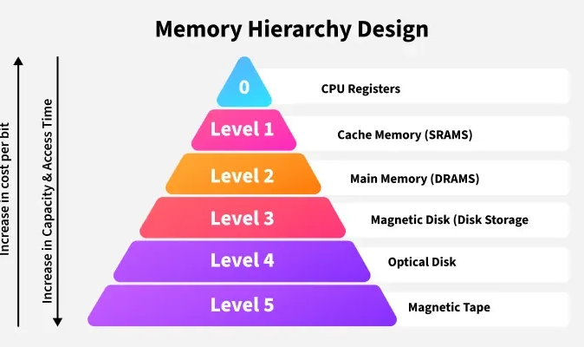

Slide 9
Module 1: Cache Memory Simulation
Functionality
Implements cache organization (Direct Mapping, Fully Associative, Set-Associative).
Handles read/write operations with Write-Through and Write-Back policies.
Tracks cache hits and misses for performance analysis.
Multi-level Cache Support (L1, L2, L3)
Add hierarchical cache layers to show how data moves from CPU to L1, then L2, L3, and finally main memory.
Demonstrates real-world processor cache design.
Input
Cache size, block size, mapping policy, memory access trace.
Output
Hit ratio, miss ratio, average memory access time, graphical/log output.

Slide 10
Module 2: Virtual Paging Simulation
Functionality
Simulates logical-to-physical address translation using a page table.
Handles page faults and applies replacement algorithms (FIFO, LRU, Optimal).
Demonstrates how virtual memory extends physical memory capacity.
Support for Multiple Page Replacement Algorithms
In addition to FIFO, LRU, and Optimal, add Clock/Second-Chance and Enhanced NRU (Not Recently Used).
Allows comparison between simple and advanced replacement policies.
Input
Page size, number of frames, sequence of memory references.
Output
Page fault rate, page replacement statistics, mapping visualization.

Slide 11
PYTHON PROGRAM
Perfomance of cache hits/misses and page faults.
pages = [1,2,3,4,1,2,5,1,2,3,4,5] # reference string
frames = [] # memory frames
capacity = 3 # number of frames
page_faults = 0
for p in pages:
if p not in frames: # page fault
page_faults += 1
if len(frames) < capacity:
frames.append(p)
else:
frames.pop(0) # FIFO replacement
frames.append(p)
print("Frames:", frames)
print("Total Page Faults:", page_faults)

Slide 12
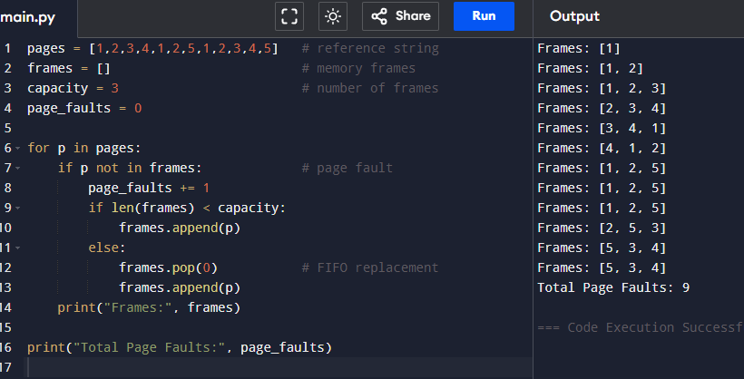
Output

Slide 13
CONCLUSION
The simulator successfully demonstrates the working of a hierarchical memory system, highlighting the interaction between cache, main memory, and virtual memory.
It provides a practical platform to understand cache mapping techniques, hit/miss ratios, and the effect of block size and associativity on system performance.
The integration of virtual paging and page replacement algorithms allows clear visualization of how page faults occur and are resolved.
Through experimentation, users gain insights into trade-offs between speed, cost, and capacity, which are crucial in memory system design.
Overall, the project contributes to a deeper understanding of memory management strategies and helps evaluate system efficiency under different configurations.

Slide 14


